Slide 1
HQ24-1876 All Dispatchable Resources RFP - Site Visit @ Rawhide Energy Center
April 1, 2024

Slide 2
Agenda
Introduce Platt River Staff
RFP Schedule
RFP Evaluation
Site Overview
Site Tour

Slide 3
Platte River Staff Present
Tyler Michie Manager, Plant Operations
Mark Siano Supervisor, System Engineering Design
Matt Tribby Senior Air Quality Engineer
Leslie Spanier Power Origination Manager
Pat Connors Director of Portfolio Strategy and Integration

Slide 4
Your safety is our top priority
Stay with your tour guide at all times
Evacuation
Storm shelter
Medical emergency
Hard hats, ear protection and safety glasses must be worn

Slide 5
RFP Schedule
Feb. 22 Platte River issues RFP
Mar. 13 Deadline for RFP questions
Apr. 1 Rawhide Site Visit
Apr. 3 Deadline for Platte River responses to RFP questions
Apr. 24 Bid proposal responses due

Slide 6
RFP Evaluation
Develop preliminary short-list
Meet minimum specifications
Follow-up calls/discussions
Develop final short-list
Internal review by senior management
Negotiate term-sheet
Negotiate PPA(s)

Slide 7
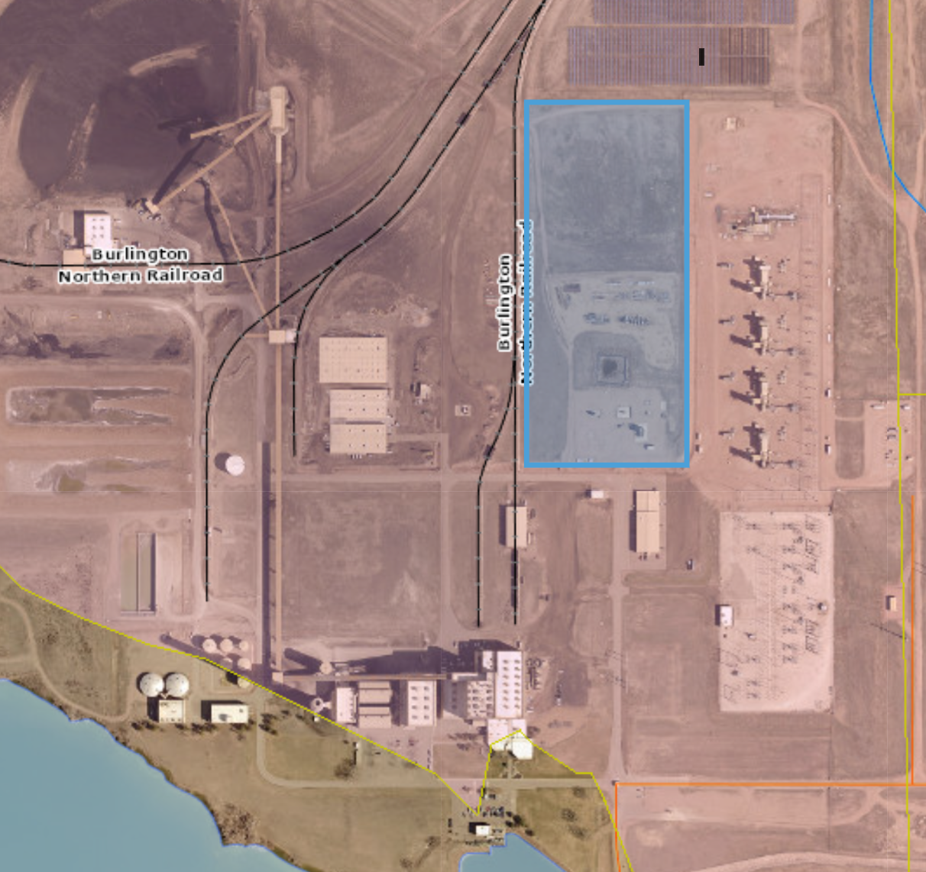
Site Overview
Platte River Power Delivery team will oversee substation expansion
Platte River Rawhide Engineering will oversee any resource construction on site
Gas Pipeline near Rawhide Substation

Slide 8
Transmission Overview
Platte River has interconnection queue position
Relying on Rawhide retirement in late 2029 & roll-over rights

Slide 9
Questions

Slide 10
Site Tour

