Slide 1
JSS car building tips
Jeremy Anderson, Resurrection Christian Middle School

Slide 2
Building competitive JSS cars
Outline of presentation:
Student objectives and buy-in
Needed / helpful tools
Building a basic car
Tear down and rebuild
Time trials and head-to-head refinement

Slide 3
Possible student objectives
Working closely as a team, students will build communication and teamwork skills to complete tasks and activities
Students will learn and implement engineering design and scientific method principles
Students will learn to use appropriate tools in a safe and productive way
Students will successfully build and race a Junior Solar Sprint car or a Lithium-Ion Car as a team

Slide 4
Buy in - spark excitement and creativity

Slide 5
Buy in - spark excitement and creativity
Youtube of JSS Races:
https://www.youtube.com/watch?v=dDO9ukpK2HM
https://www.youtube.com/watch?v=wxSQ9G4UqPE
Show cars from previous years
Science application: World Solar Car Challenge
Learning to use new tools

Slide 6
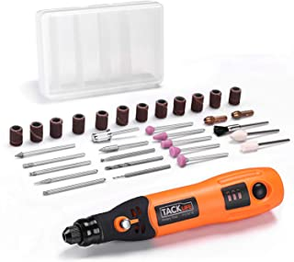
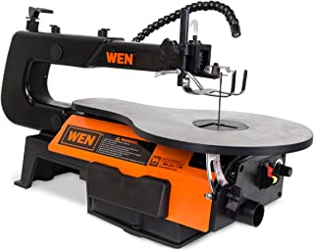
Needed/helpful tools
Rulers / pencils / graph paper
Cold-melt hot glue guns
Permanent glue (like Gorilla Glue)
Soldering iron kit
Pliers of various sizes
Sandpaper / files
Scroll saw
Mini Dremel (diamond cutting disk)
Exacto knife / saw (maybe..)

Slide 7
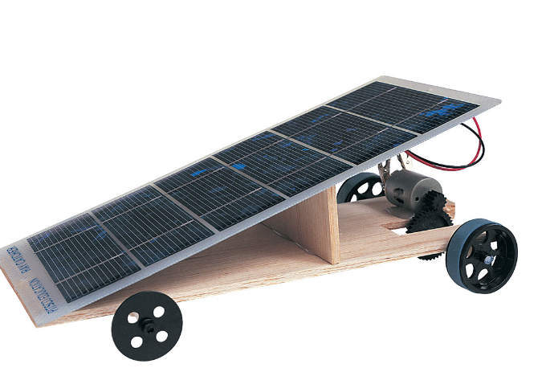
Build/race a basic car (1.5 hour)
Instructions are provided with JSS kits or online
Hints:
Rulers / pencils
Tack with hot glue
Teamwork!
Drill bit for gears

Slide 8
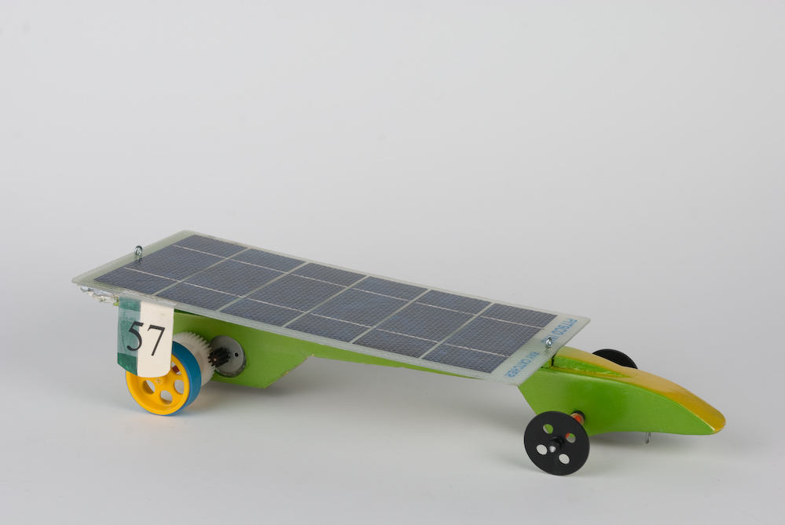
Tear down basic car - rebuild
Goals: cut weight / reduce friction
Get creative
Wheels / drives
Solar panel mounting
Materials: plexiglass, 3D printed, CarbonFiber, PVC
Hints:
Graph paper templates
Tack with hot glue
Gear ratio 3:5

Slide 9
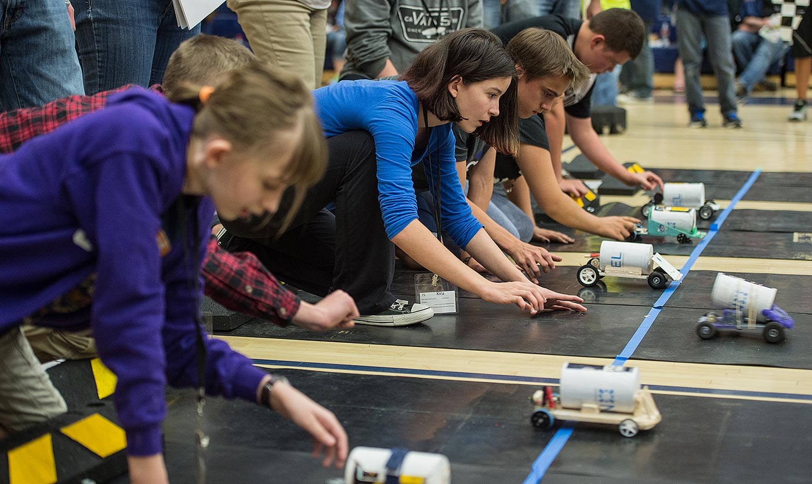
Time trials and head-to-head refinement
Trials to drive improvement
Change ratios
Realign wheels/axles
Change guide clip placement
Hints:
Slipping gears/wheels
Alligator clips broken
Axles not aligned
Solidify one thing at a time (Gorilla Glue, cutting weight/axles, etc.)

Slide 10
Q&A

